Slide 1
ITMO UNIVERSITY
FACULTY OF CONTROL SYSTEMS AND ROBOTICS
COURSE: MACHINE LEARNING IN ROBOTICS
INSTRUCTORS
Professor S. Kolyubin
Professor A.A. Vedyakov

Slide 2
ITMO UNIVERSITY
Research on Increasing the Robustness of 3D Gaussian Splatting via Masking Dynamic Objects
BY
486554_Mandengs C I
476149_Jacob Ahemen
474343_Prince Alex
December 2025

Slide 3
1.1: 3D Gaussian Splatting Overview
SECTION ONE:
3D Gaussian Splatting (3DGS) is a state-of-the-art rendering method that reconstructs highly realistic 3D scenes from 2D images or video footage, delivering real-time performance and enabling high-quality synthesis of new viewpoints.
Each Gaussian Stores:
3D position
Covariance (size and orientation)
Color (spherical harmonics)
Opacity

Slide 4
ITMO UNIVERSITY
1.2 MOTIVATION
3D Gaussian Splatting (3DGS) enables real‑time, photorealistic 3D scene reconstruction and is increasingly deployed in robotics, SLAM, AR, and autonomous systems. It performs best with static scenes.
Notes:
3D Gaussian Splatting reconstructs 3D scenes very well when everything is static, but in real environments moving objects (people, cars, robot arms) cause ghosting, smearing, and unstable geometry.
3D Gaussian Splatting (3DGS) is a state‑of‑the‑art real‑time 3D reconstruction method now widely deployed in robotics (manipulation, localization), AR/VR applications, and SLAM systems. For robots operating in real environments—factory floors, collaborative workspaces, outdoor navigation—the need for fast, accurate scene reconstruction is paramount. Yet 3DGS has a fundamental limitation: it assumes the scene is static throughout capture. This assumption is violated whenever robots, people, or other moving agents appear in the environment.

Slide 5
1.2 Problem Statement
ITMO UNIVERSITY
3DGS assumes static scenes – in reality, scenes are rarely static.
Dynamic objects introduce noise, instability, and artifacts.
The need to produce cleaner, more stable reconstructions that better capture the underlying static geometry, ultimately enhancing the practicality of 3DGS for applications.
Notes:
This project asks whether using simple 2D masks to ignore those dynamic pixels during training can make standard 3DGS robust enough for cleaner static reconstructions in robotics and similar applications.

Slide 6


SECTION TWO: METHODS
ITMO UNIVERSITY
2.1 Overview of Masking Strategies Employed
- Strategy 1: Loss Masking (Gradient Masking)
$ℒ_{\text{mask}}=\frac{\sum_{u}{M}\left(u\right)⋅\text{error}\left(u\right)}{\sum_{u}{M}\left(u\right)+ε}$: simplified as
where:
$u$: pixel index
$M\left(u\right)=1$if pixel $u$is static, $0$if dynamic
$\text{error}\left(u\right)$: per-pixel photometric error (e.g., $∥c_{u}^{\text{render}}−c_{u}^{\text{gt}}∥_{1}$)
$ε$: small constant (e.g., ${10}^{−8}$) to avoid division by zero
- Strategy 2: Ray Filtering (Geometry Masking)
$$α_{i}^{\text{eff}}\left(u\right)=M\left(u\right)⋅α_{i}\left(u\right)$$
where:
$u$: pixel (ray) index
$i$: Gaussian index along ray $u$
$α_{i}\left(u\right)$: original opacity of Gaussian $i$at pixel $u$
$M\left(u\right)=1$for static rays, $0$for dynamic rays
$α_{i}^{\text{eff}}\left(u\right)$: effective opacity used in compositing
$$L_{mask}=\frac{1}{N}\sum{{(I_{predicted} −I_{gt})}^{2} ∗ M}$$
Notes:
1. Gradient Masking (Loss Masking) – Weight loss by (1-mask).
It down-weights masked pixels in loss.
Maintains structural integrity
Simpler to implement.
2. Ray Filtering – Discard rays passing through dynamic regions.
Removes masked rays fully from training
Higher PSNR
Sharper geometry
3. Baseline (unmasked) - trains 3D Gaussian Splatting normally.
uses all pixels from all training images
No mask guidance

Slide 7


2.2: Evaluation Metrics
ITMO UNIVERSITY
PSNR(PEAK SIGNAL-TO-NOISE RATIO
MSE = (1/(HW)) Σ (I_ij − K_ij)^2
PSNR (x,y) = $10\log_{10}{(\frac{L^{2}}{MSE}})$
Higher = better reconstruction
SSIM Formula
SSIM(x, y) = $\frac{(2µ_{x}µ_{y}+C_{1})(2σ_{xy}+C_{2})}{(µ_{x}^{2}+µ_{y}^{2}+C_{1})(σ_{x}^{2}+σ_{y}^{2}+C_{2})}$
Measures luminance, contrast, structure
Higher = more accurate
LPIPS Formula
LPIPS (x, y) = $\sum_{l}{\frac{1}{H_{l}W_{l}}\sum_{h, w}{||w_{l}⊙({\hat{y}}_{h, w}^{l} − }}{\hat{x}}_{h, w}^{l})||{}_{2}^{2}$
Feature-based perceptual similarity
Lower = more perceptually similar
L = maximum possible pixel value of the image (e.g., 1.0 if normalized, 255 if 8-bit)
MSE=BTW predicted and ground truth images:
x, y = local patches of predicted and ground truth images
μx​, μy​ = mean pixel intensity of x and y
σx2​,σy2​ = variance of x and y
σxy​ = covariance between x and y
Others= Stabilization constants
x, y = images
$${\hat{x}}^{l}, {\hat{y}}^{l}:feature activations of a pretrained network (e.g., AlexNet, VGG) at layer l$$
$$w_{l}= learned per−channel weights for layer l$$
$$H_{l}, W_{l} = spatial dimensions of layer l$$
Notes:
PSNR_DEF: L = maximum possible pixel value of the image (e.g., 1.0 if normalized, 255 if 8-bit)
MSE=BTW predicted and ground truth images:
SSIM_DEF: x, y = local patches of predicted and ground truth images
μx​, μy​ = mean intensity of x and y
σx2​,σy2​ = variance of x and y
σxy​ = covariance between x and y
Others= Stabilization constants
LPIPS_DEF: x, y = images
$${\hat{x}}^{l}, {\hat{y}}^{l}:feature activations of a pretrained network (e.g., AlexNet, VGG) at layer l$$
$$w_{l}= learned per−channel weights for layer l$$
$$H_{l}, W_{l} = spatial dimensions of layer l$$

Slide 8
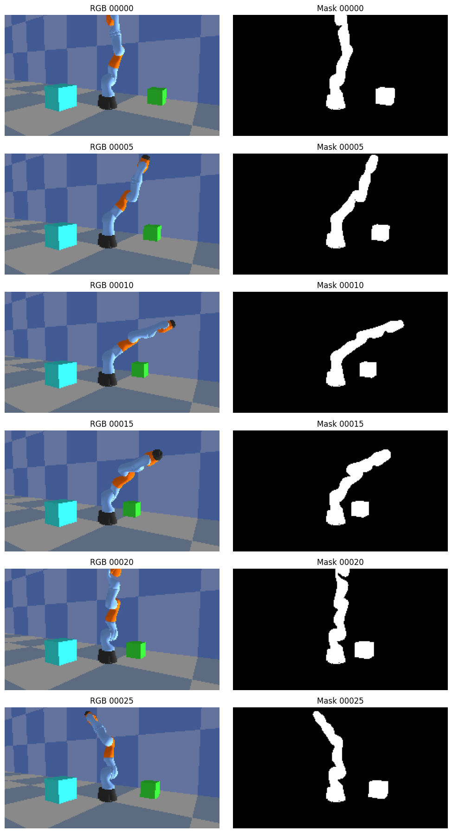
ITMO UNIVERSITY
2.3: 2D MASKING IN 3DGS – why?
Since dynamic objects in scenes cause reconstruction artifacts in 3D Gaussian Splatting the goal of masking is to improve reconstruction fidelity using 2D semantic masks.
Hypothesis: For 2D binary masks (1 = static, 0 = dynamic) integrated during training eliminates static artifact error while maintaining efficiency.ML in Robotics 202510\mask creation.png
Fig. 2.1 : Image ground truth and masked image

Slide 9
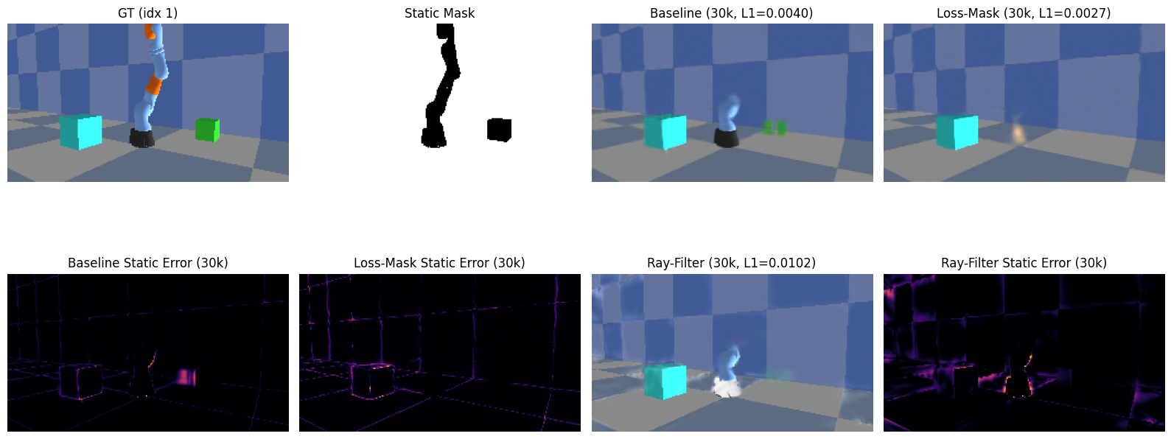
SECTION 3: RESULTS
ITMO UNIVERSITY
https://colab.research.google.com/drive/12VdjSFE5eK1fUsKlF-G-qNppZZy0ad4O?authuser=1#scrollTo=0uDc8xoIQOTy&line=80&uniqifier=1
Compare PSNR/SSIM/LPIPS for each masking strategy
Ray filtering typically yields sharper details
Gradient masking smooth but robust
Fig 3.0: Ground Truth vs Masked Images
Notes:
Compare PSNR/SSIM/LPIPS for each masking strategy
Ray filtering typically yields sharper details
Gradient masking smooth but robust

Slide 10
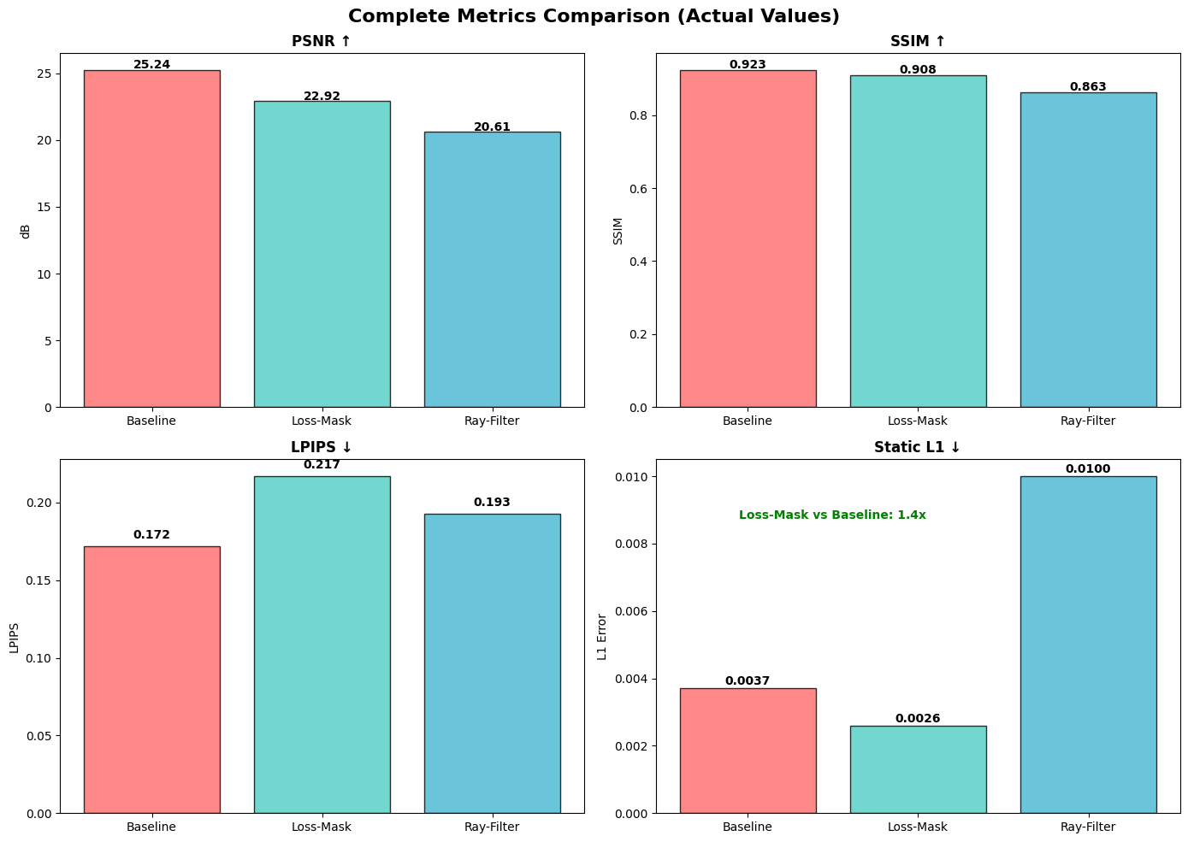
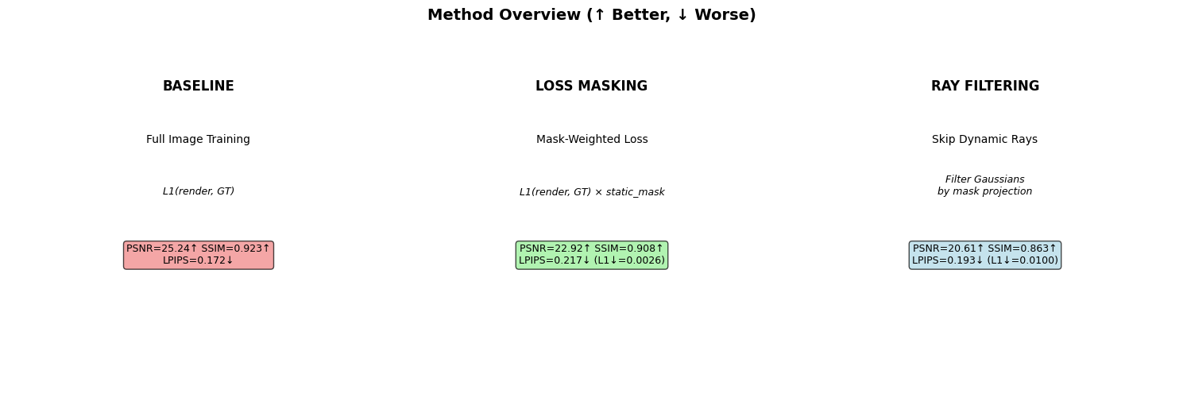
3.2: Quantitative Results
Metrics ComparisonML in Robotics 202510\3dgs traing Results\comparison_figures_actual.png
Fig. 3.1A: Bar chart view per methods
Fig. 3.1B: Bar chart view per methods

Slide 11
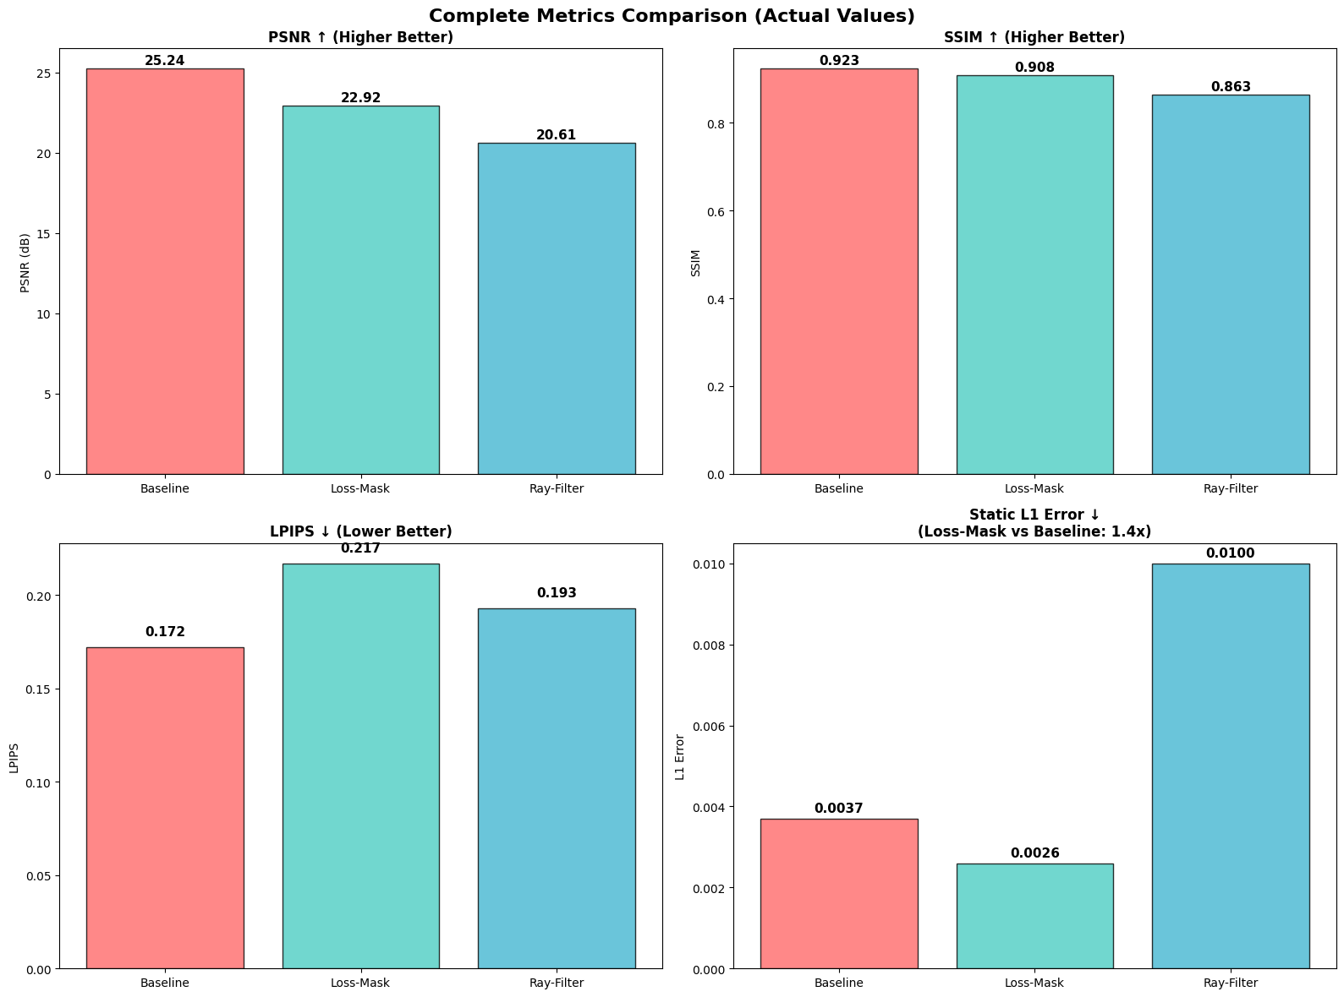
OVERALL METRIC COMPARISON
Fig. 3.1C: Overall Metric Comparison

Slide 12
3.3: Conclusions
ITMO UNIVERSITY
Integrating dynamic masks into the 3DGS training pipeline effectively produces cleaner static reconstructions in dynamic scenes
Loss Masking offers a practical path to robustness without modifying core 3DGS architecture
Gradient masking slightly better perceptually than ray filtering but keeps partial information.
3.4: Limitations
This work was carried out using synthetic data
The system depends on mask quality to achieve higher quality reconstruction
Simple scene design
3.5: Future work
Learn masks automatically e.g by using segmentation network to apply to real-world videos
Extend from static-scene robustness to full dynamic-scene modelling e.g by combining static 3DGS with 4D Gaussians

